Slide 1


Bank System Project
By: Eng. Ahmed Mohammed Arafa
Date: 21/7/2024
Final Project of Automotive Embedded Systems Scholarship by IMT-School

Slide 2
Outlines:
Introduction to the project.
Sequence diagram of the project.
Client System overview.
Server System overview.
File Management System overview (Database).
State Diagram for each application.
State Diagram for the whole system.

Slide 3
Introduction to the project
This Project is developed by Qt/C++ and it depends on 3 Sections:
1. Client System.
2. Server System.
3. Files Management System (Database System).

Slide 4
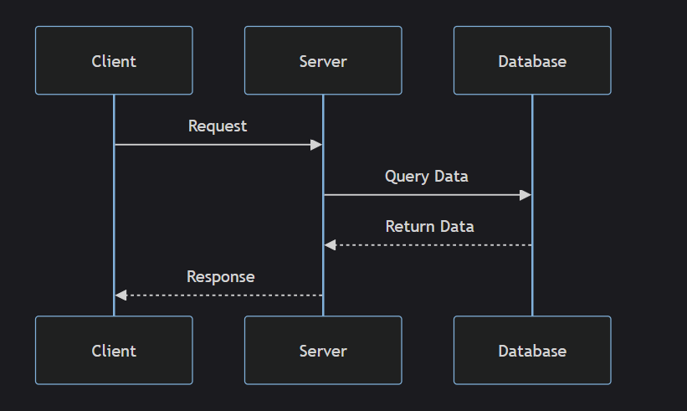
Sequence Diagram of the Project

Slide 5
Client System
This is a GUI Application used to handle Requests of users and admins of the bank system.
After connecting to the server, the client system will switch to two main processes:
1. It will handle requests of the client by sending it to the server in CSV Format (Comma Separated Variable Format).
2. then it receives the required response also in CSV format and it process it by response handler to be readable on the GUI widget.

Slide 6
Client System
Main Components of the Client System:
1. GUI System:
This system is a Many Different widgets which is controlled to show or hide by pointers, each Window has its 3 Files:
A. Window.cpp
B. Window.h
C. Window.ui
In the GUI system, each request has its own window, and all windows are controlled by push buttons to increase readability, portability, and reusability.
This is used to apply the OCS SOLID principle.

Slide 7
Client System
Main Components of the Client System:
2. Client Class:
This class handles the connection & Data transfer with server.
3. Response Handler Classes:
These are classes designed in a chain of responsibility Design pattern used handle server response to be readable for the user.
4. Signals Handler Class:
This class inherits from QObject to send data to the GUI system using signals and slots.

Slide 8
Server System
This is a console application, its main functionality is handling responses of different clients concurrently by making new thread with each new socket connection.
Server system sequence:
1. After a client application connected to the server, the Server makes a new thread of a server handler class to handle the client requests concurrently to the main server application.
2. Server Handler class divide data into Request and Info and send it to a Request handler class, to handle the data, then interact to the file management system and finally return response to Server Handler class.

Slide 9
Server System
Main components of Server System:
1. Server Class:
This class Inherits from QTcpServer and used to handle new connections of classes and make a thread works concurrently with each new Connection.
2. Server_Handler Class:
This is a class inherits from QThread and its main functions is to send and receive data to and from Client, and also send requests to be processed by Request Handler classes.

Slide 10
Server System
Main components of Server System:
3. Server_Request_Handler Classes:
These classes use the Chain of Responsibility design pattern to manage client requests and return responses.
4. File Management System classes:
These classes use Prototype design pattern to manage Json Database files.

Slide 11
File Management System
File Management System consists of four Json files which is created using Prototype design pattern.
This File System is used to interact with server handler class to load and update data of files.
File Management System Components:
1. Login Database file:
This file contains login info for admins and users:
1. Email.
2. Password.
3. Account Number.

Slide 12
File Management System
File Management System Components:
2. Accounts database file:
This file contains users general info such as:
1. Account Number.
2. User Name.
3. User Age.
4. User account type (Platinum, VIP, etc).
5. Account balance.

Slide 13
File Management System
File Management System Components:
3. Transaction History file:
This file contains transaction history Starts with last transaction of the account, and it is divided into two different types
1. Direct transaction by user himself.
2. Indirect transaction, this is done by another users by Transfer Funds to Another Account Request.
This file Contains:
1. User Account Number.
2. User Transaction History.

Slide 14
File Management System
File Management System Components:
4. Requests log file:
This file contains a history of user requests and the time of each request
The user requests history start with the last request
This file Contains:
1. User Account Number
2. User Requests History

Slide 15
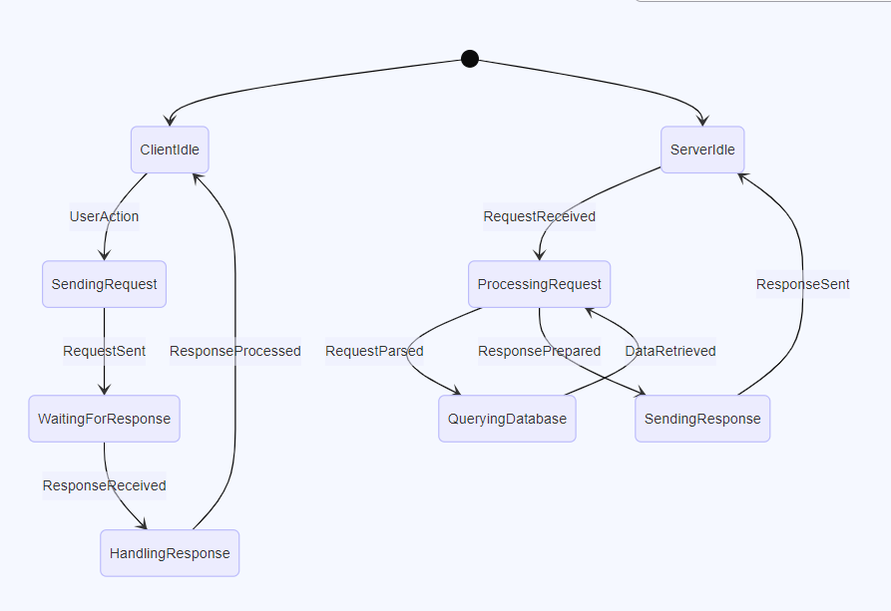
State Diagram for each Application

Slide 16
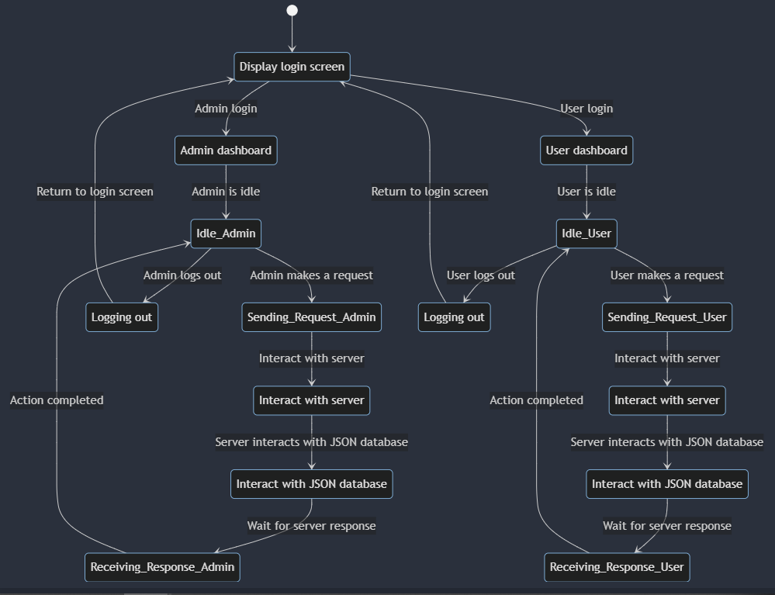
State Diagram for Bank System

Slide 17


